Slide 1
MESSAGE AUTHENTICATION CODE
A SHARED SYMMETRIC KEY APPROCH…

Slide 2
Types Of Attack On MA
Protecting message content (i.e. secrecy) by encrypting the
message. Now consider→
-> How to protect message integrity(i.e. protection from
modification)
-> Confirming the identity of the sender.
Data received are exactly as sent by without modification,
insertion, deletion.
Requirements of Authentication----
Disclosure- (Access message without key)
Traffic analysis - (discover the pattern)
Sequence modification- (insert, delete, reorder)
Masquerade-(insert message from illegal/ source)
Content modification.
Timing modification - (delay or replay)
Source repudiation - Source refuses after transmission (denial of a transmission)
Destination repudiation - (denial of a receipt)

Slide 3
Authentication Functions
Msg authentication has two levels of functionality
1st level- used to produce authenticator. [aim is to authenticate the user]
Higher level-verify the authentication of msg.

Slide 4
The 3 Alternative Functions Used As Authenticator
Msg encryption - cipher text acts as authenticator.
Msg authentication code [MAC] -
- Produce a fixed length value as authenticator.
Hash function[HMAC] - Produce a fixed length hash value as authenticator.

Slide 5
1.Msg encryption
1]Symmetric encryption
2]Asymmetric encryption
------------------------------------------------------1]Symmetric encryption
A B
E
D
M
C
M
K
K
E(k,m)
Private key encryption:- Confidentiality & Authentication

Slide 6
2]Asymmetric encryption
A
B
E
D
M
C
M
PUb
PRb
E(PUb,M)
Public key encryption:- confidentiality
A
B
E
D
M
C
M
PRa
PUa
E(PRa,M)
Public key encryption:- Authentication,
Signature

Slide 7
A
E
E
M
C
C1
PRa
PUb
E(PRa,m)
E(PUb,E(PRa,m))
B
D
D
M
C
C1
PUa
PRb
E(PRa,m)
Public key encryption : - Confidentiality, Authentication & signature

Slide 8
2.Message Authentication code
hash includes a key along with the message.
Use Secret key to generate a small fixed size block of data called Cryptographic checksum or MAC.
It is appended to msg.
A want to send a msg to B
A calculates MAC=C(k,m)
M- i/p msg
K- secret key
C- MAC fun

Slide 9
Message Authentication Code
Assume both uses share secret key k
Procedure
  Sender computes MAC=C_{k}(M) for M
  Sent M and MAC of it to receiver
  Receiver computes the MAC on received M
  Compare it with received MAC
  If match, then accepts the message else reject.
MAC is similar to encryption, but not need to be reversible!
This scheme provides authentication but not confidentiality.
Confidentiality can be provided by performing message encryption either after or before the MAC algorthim.

Slide 10
M
C
II
K
M
Compare
C(k,m)
C
K
a) Msg Authentication
E
D
II
M
k2
C
K2
E(k2[M||c(k1,M])
K1
M
C
Compare
C(k,m)
K1
b)Msg authentication & confidentiality tied to plain text

Slide 11
E(k2,m)
E
II
M
C
K2
C(k1,E(k2,m))
k1
M
D
C
K2
k1
Compare
b)Msg authentication & confidentiality tied to ciphet text

Slide 12
Significant of MAC
Assure that msg is not alter.
Assure that msg come from authenticate sender.
Receiver get proper sequence.
In MAC sender & Receiver are performing encryption process, so MAC algo need not be reversible.
It is sufficient to be a one-way function only.

Slide 13
Applications of MAC
Same Msg broadcasting.
MAC is uesd to authenticate SNMP msg.
Reduce decryption time when heavy load.
MAC is much less expensive than en/decryption.
sometimes only authentication is needed.

Slide 14
3.HMAC
->Requirements
Used in IP & SSL.
Reuse the existing MD algorithm. (i.e:- there is no point in re-investing the wheel.)
That is, it treats the MD as a black box.
Blackbox use of hash without modification.
Not much overhead than original hash.
Easy to replace the hash module
  Easy to upgrade security

Slide 15
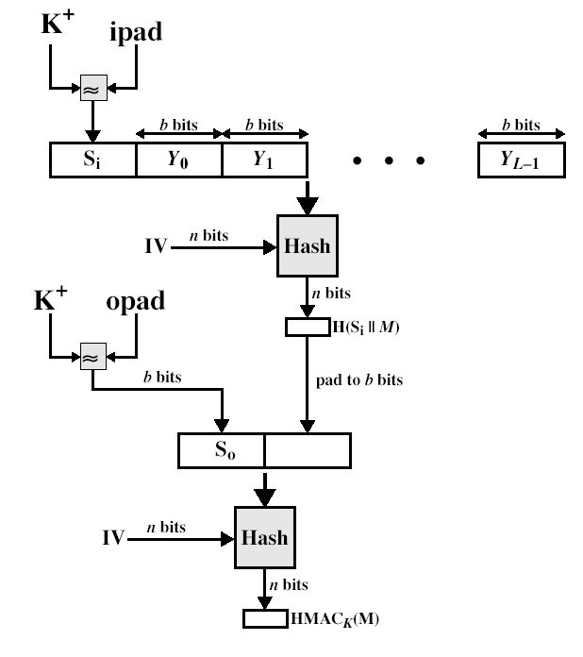
HMAC Overview

Slide 16
HMAC Algorithm
specified as Internet standard RFC2104
uses hash function on the message:
  HMAC_{K} = Hash[(K⁺ XOR opad) ||
  Hash[(K⁺ XOR ipad)||M)]]
where K⁺ is the key padded out to size
and opad, ipad are specified padding constants
overhead is just 3 more hash calculations than the message needs alone
any of MD5, SHA-1 can be used

Slide 17
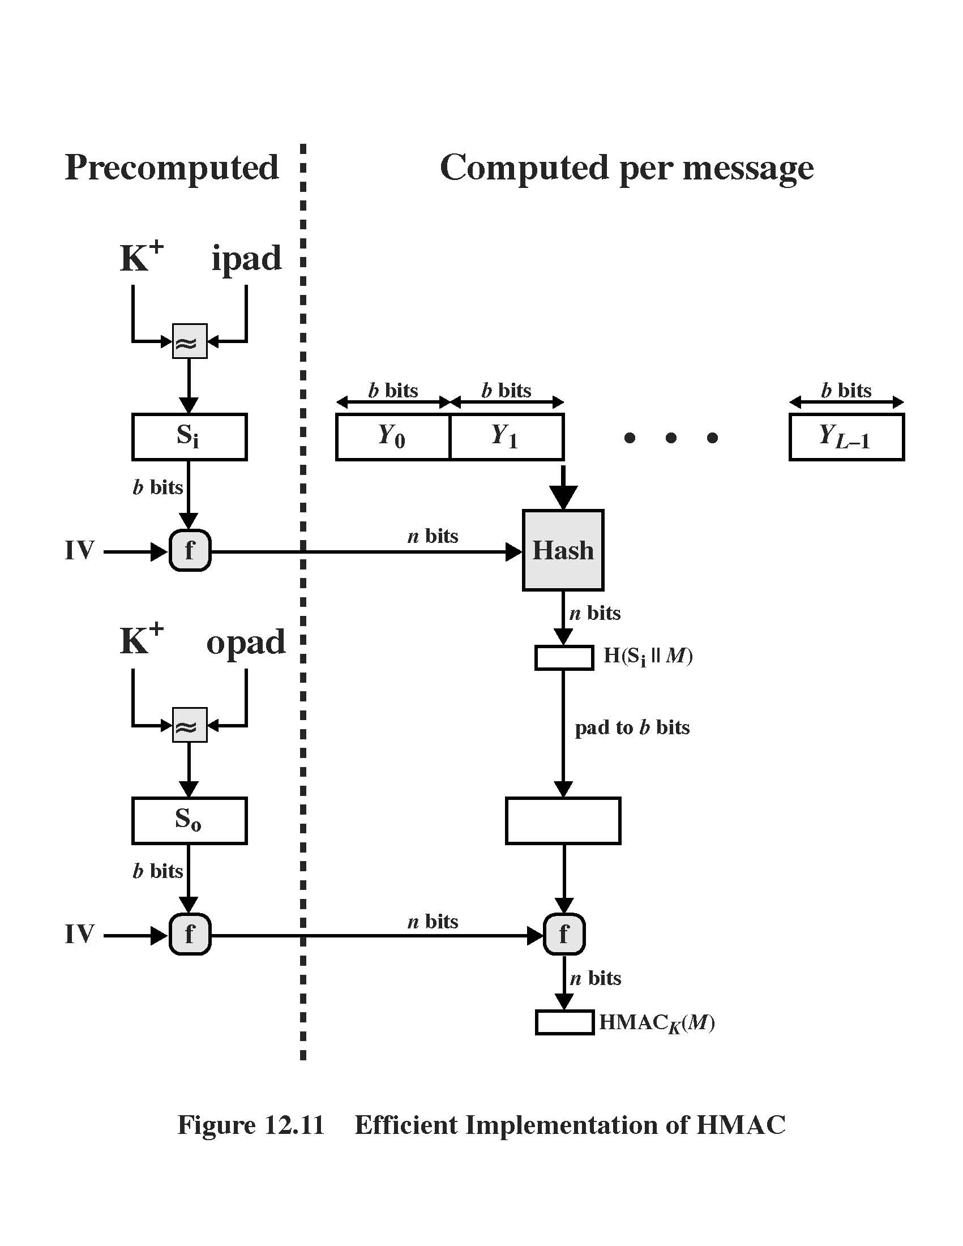
HMAC Algorithm

